Slide 1
Mathematical Analysis of Recursive Algorithms
Prodi Teknik Informatika
Fakultas Teknologi Informasi

Slide 2
Factorial Function
Tower of Hanoi
Binary Representation Function

Slide 3
Factorial Function

Slide 4

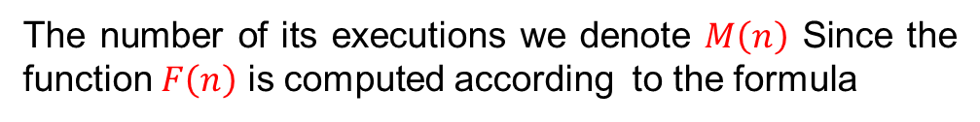

Compute the Factorial Function
$$5!=1 ×2×3×4×5$$
Example: Compute the factorial function F(n) = n!, for arbitrary a non-negative integer n. Since
$$n!=1∙,…,\left(n−1\right)∙n=\left(n−1\right)!∙n for n≥1$$
And 0! = 1 by definition, we can compute $F\left(n\right)=F(n−1)∙n$ with the following recursive algorithm
$$F\left(5\right)=F\left(4\right)∗5$$
ALGORITHM : F(n)
if$n==0 return 1$
$$else return F\left(n−1\right)∗n$$
public static void factorial (int n){
if(n == 0 )
return 1;
return factorial (n-1)*n
}
The basic operation of the algorithm is the multiplication.
The number of its executions we denote $M\left(n\right)$ Since the function $F\left(n\right)$ is computed according to the formula
$$F\left(n\right)=F\left(n−1\right)∙n for n>0,$$

Slide 5
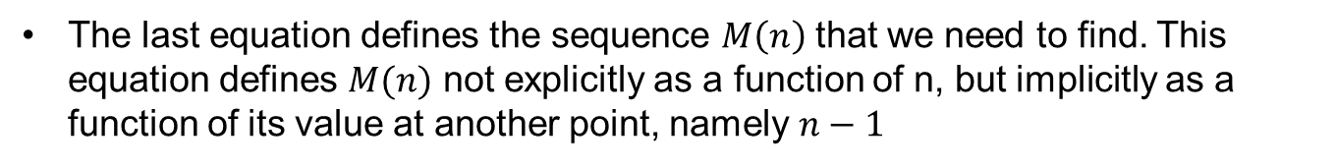
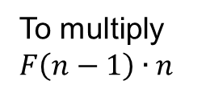
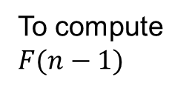
Compute the Factorial Function
The number of multiplications $M\left(n\right)$ needed to compute it must satisfy the equality
$$M\left(n\right)=M\left(n−1\right)+ 1 for n>0$$
To compute $F(n−1)$
To multiply $F\left(n−1\right)∙n$
The last equation defines the sequence $M\left(n\right)$ that we need to find. This equation defines $M(n)$ not explicitly as a function of n, but implicitly as a function of its value at another point, namely $n−1$
Such equations called recurrence relations or recurrences.
The goal is to solve the recurrence relation $M\left(n\right)=M\left(n−1\right)+1$to find the explicit formula for $M(n)$ in terms of n only.

Slide 6
Compute the Factorial Function
To determine a solution uniquely, we need an initial condition that tell us the value with which the sequence starts.
We can obtain this value by inspecting the condition that makes the algorithm stop its recursive calls:
$$if n==0 return 1$$
$$M\left(0\right)= 0$$
The calls stop when n = 0
No multiplication needed when n = 0
Thus, we succeeded in setting up the recurrence relation and initial condition for the algorithm’s number of multiplication $M\left(n\right):$
$$M\left(n\right)=M\left(n−1\right)+1 for n>0$$
$$M\left(0\right)=0.$$
From the several techniques available for solving recurrences relations, we use what can be called the method of backward substitutions

Slide 7
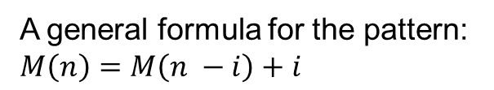
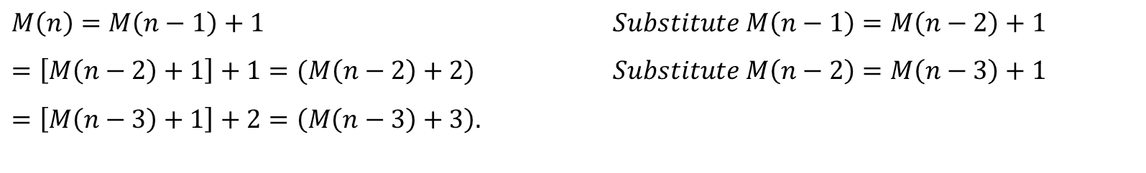
Compute the Factorial Function
Backward Substitions
$$M\left(n\right)=M\left(n−1\right)+1$$ | $$Substitute M\left(n−1\right)=M\left(n−2\right)+1$$
$$=\left[M\left(n−2\right)+1\right]+1=(M\left(n−2\right)+2)$$ | $$Substitute M\left(n−2\right)=M\left(n−3\right)+1$$
$$=\left[M\left(n−3\right)+1\right]+2=\left(M\left(n−3\right)+3\right).$$
A general formula for the pattern: $M\left(n\right)=M\left(n −i\right)+i$
Since it is specified for $n=0,$ we have to subtitute $i=n,$ in the pattern ‘s formula to get an ultimate result:
$$M\left(n\right)=M\left(n −1\right)+1= …=M\left(n−i\right)+i=…=M\left(n−n\right)+n=M\left(0\right)+n=0+n=n \sim O(N)$$

Slide 8
General Plan for Analyzing the Time Efficiency of Recursive Algorithms
Decide on a parameter (or parameters) indicating an input’s size.
Identify the algorithm’s basic operation.
Check whether the number of times the basic operation is executed can vary on different inputs of the same size; if it can, the worst-cae, average-case, and best-case must be investigated separately.
Set up, recurrence relation, with an appropriate initial condition, for the number of times the basic operation is executed.
Solve the recurrence or, at least, ascertain the order of growth of its solutions

Slide 9
Tower of Hanoi Puzzle

Slide 10
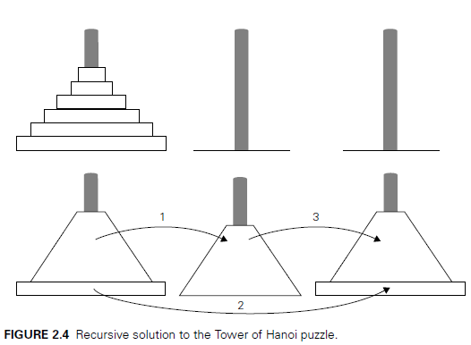
Tower of Hanoi
All the disk are on the first peg in order of size, the largerst on the bottom and the smallest on the top.
The goal is to move all the disk to the third peg, using the second one as an auxiliary, if necessary we can move only one disk a time, and its forbidden to place a larger disk on top of a smaller one.
The problem has an elegant recursive solution. Which is ilustrated at the left side of the slide.
This figure is obtained from the book Introduction of Design and Analysis Algorith^{3rd}, Chapter 2 Page 99

Slide 11
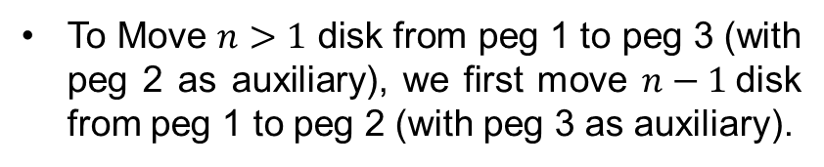
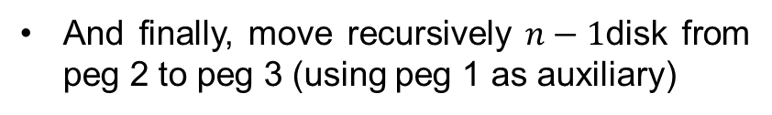
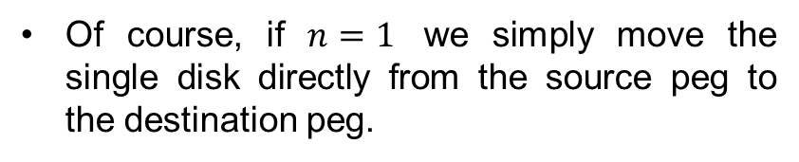
Tower of Hanoi
To Move $n>1$ disk from peg 1 to peg 3 (with peg 2 as auxiliary), we first move $n−1$disk from peg 1 to peg 2 (with peg 3 as auxiliary).
Then move the largest disk directly from peg 1 to peg 3.
And finally, move recursively $n−1$disk from peg 2 to peg 3 (using peg 1 as auxiliary)
Of course, if $n=1$ we simply move the single disk directly from the source peg to the destination peg.
This figure is obtained from the book Introduction of Design and Analysis Algorith^{3rd}, Chapter 2 Page 99

Slide 12
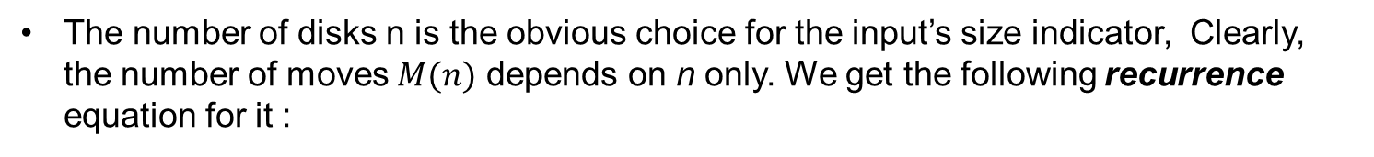
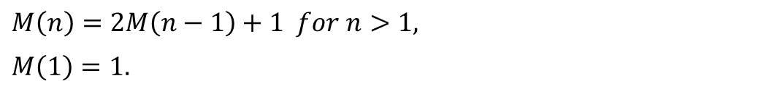
Tower of Hanoi
The general plan outlined above to the power of Hanoi problem
The number of disks n is the obvious choice for the input’s size indicator, Clearly, the number of moves $M(n)$ depends on n only. We get the following recurrence equation for it :
$$M\left(n\right)=M\left(n−1\right)+1+M\left(n−1\right) for n>1$$
The initial condition $M\left(1\right)=1$, we have the following recurrence
$$M\left(n\right)=2M\left(n−1\right)+1 for n>1,$$
$$M\left(1\right)=1.$$
We solve this recurrence by the same method of Backward subtitutions :

Slide 13
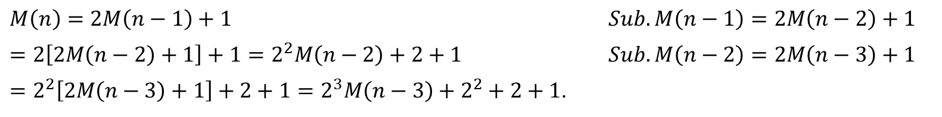
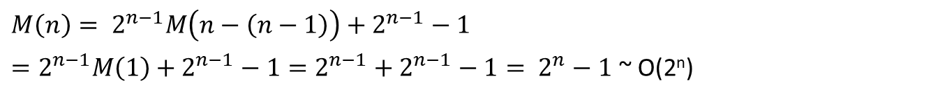
Tower of Hanoi
We solve this recurrence by the same method of Backward subtitutions :
$$M\left(n\right)=2M\left(n−1\right)+1$$ | $$Sub. M\left(n−1\right)=2M\left(n−2\right)+1$$
$$=2\left[2M\left(n−2\right)+1\right]+1=2^{2}M\left(n−2\right)+2+1$$ | $$Sub. M\left(n−2\right)=2M\left(n−3\right)+1$$
$=2^{2}\left[2M\left(n−3\right)+1\right]+2+1=2^{3}M\left(n−3\right)+2^{2}+2+1$.
The pattern of the first three sums on the left suggest that the next one will be :
$$=2^{4}M\left(n−1\right)+ 2^{3}+2^{2}+2+1$$
And generally, after i substitutions, we get
$$M\left(n\right)=2^{i}M\left(n−i\right)+2^{i−1}+2^{i−2}+…+2+1=2^{i}M\left(n−i\right)+2^{i}−1$$
Since the initial condition is specified for n = 1, which is achieved for $i=n−1,$we get the following formula
$$M\left(n\right)= 2^{n−1}M\left(n−\left(n−1\right)\right)+2^{n−1}−1$$
$=2^{n−1}M\left(1\right)+2^{n−1}−1=2^{n−1}+2^{n−1}−1= 2^{n}−1$ ~ O(2^{n})
Thus, we have an exponential Algorithm

Slide 14
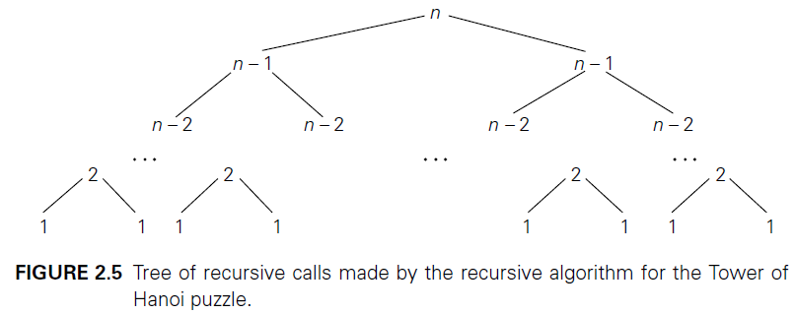
Tower of Hanoi
This figure is obtained from the book Introduction of Design and Analysis Algorith^{3rd}, Chapter 2 Page 101
$$C\left(n\right)= \sum_{l=0}^{n−1}{2^{l}}\left(where l is the level in the tree in figure 2.5\right)= 2^{n}−1$$

Slide 15
Binary Digit Representation

Slide 16
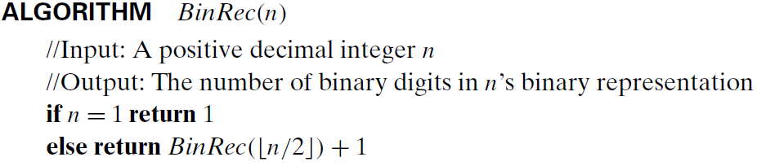
Binary Digit Representation
Look at the algorithm that written below
This figure is obtained from the book Introduction of Design and Analysis Algorith^{3rd}, Chapter 2 Page 101
Lets denotes the execution of its basic operation as $A(n)$
The number of additions made in computing $BinRec(\left\lfloor n/2\right\rfloor )$ is $A(\left\lfloor n/2\right\rfloor )$ and plus more addition is made by the algorithm to increase the returned value by 1.

Slide 17
Binary Digit Representation
Lets denotes the execution of its basic operation as $A(n)$
The number of additions made in computing $BinRec(\left\lfloor n/2\right\rfloor )$ is $A(\left\lfloor n/2\right\rfloor )$ and plus more addition is made by the algorithm to increase the returned value by 1.
$A\left(n\right)=A\left(\left\lfloor n/2\right\rfloor \right)+1 for n>1$
Since the recursive calls end when n is equal to 1 and there are no additions made then, the initial condition is
$A\left(1\right)=0.$
The presence of $\left\lfloor n/2\right\rfloor$in the function’s argument makes the method of backward substitutions stumble.
Therefore, the standard approach to solving such a recurrence is to solve it only for $n= 2^{k}$
after getting a solution for powers of 2, we can sometimes fine-tune this solution to get a formula valid for an arbitrary n.)

Slide 18
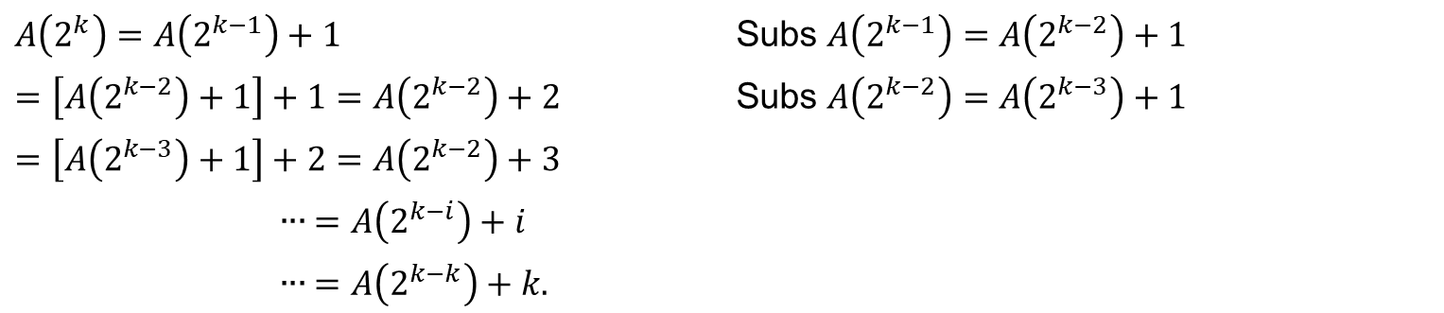
Binary Digit Representation
$$A\left(2^{k}\right)=2^{k−1}+1 for k>0$$
$$A\left(2^{0}\right)=1$$
Now backward substitutions encounter no problems:
$$A\left(2^{k}\right)=A\left(2^{k−1}\right)+1$$ |  | Subs $A\left(2^{k−1}\right)=A\left(2^{k−2}\right)+1$
$$=\left[A\left(2^{k−2}\right)+1\right]+1=A\left(2^{k−2}\right)+2$$ |  | Subs $A\left(2^{k−2}\right)=A\left(2^{k−3}\right)+1$
$$=\left[A\left(2^{k−3}\right)+1\right]+2=A\left(2^{k−2}\right)+3$$
 | $$∙∙∙ =A\left(2^{k−i}\right)+i$$
 | $$∙∙∙ =A\left(2^{k−k}\right)+k.$$
Thus, we end up with
$$A\left(2^{k}\right)=A\left(1\right)+k,$$
After returning to the original variable $n=2^{k}$ and hence $k= \log_{2}n,$
$$A\left(n\right)= \log_{2}n∈O(\log{n})$$

